Slide 1
MBC 638 Project:
Reduce Daily Spending by 20%
By Cindy Khuu

Slide 2
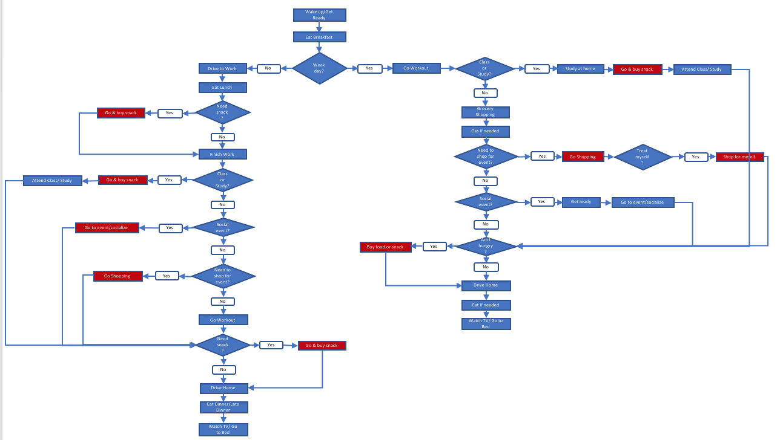
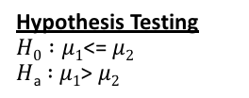
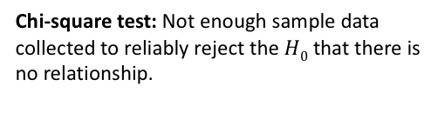
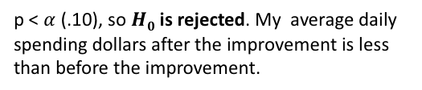
Executive Summary: Reduce Daily Spending Project
Process Owner: Cindy Khuu
Key Dates→
Project Launch
4/11
Define
4/13
Measure
4/15
Analyze
5/11
Improve
5/15
Control
6/15
DEFINE
MEASURE
ANALYZE
IMPROVE
SQL= 2.3
Problem to Solve:
Not paying off credit card balance at expected pace.
Spending too much money.
Collected Data on 15 Variables: Total Dollar Spent (Y), Minutes Spent on Shopping for Event(X1), Snack Runs(X2), Self Gifting (X3), Socializing(X4), Groceries (X5), Meals (X6), and Gas (X7), etc.
Hypothesis Testing
$H0 :μ1$<= $μ2$
$H$_{a} $:$ $μ1$> $μ2$
Changes made to process:
Eliminating snack runs by buying bulk snacks and keeping in bag and in car when needed
Dedicate to daily budget of no more than $50 per day
Reduce time spent on Shopping for Event, Social Events, and Snack Runs.
p < $α$ (.10), so $H0$ is rejected. My average daily spending dollars after the improvement is less than before the improvement.
•80% of dollars spent and time spent on Shopping for Event, Snack Runs, and Socializing.
• Strong positive correlation between the dollars and time spent for these activities.
Regression Model
Y = 16.028+ 0.386X₁+0.455X₂ +1.25X₃+ 0.570X₄ +0.502X₅ +2.131X₇-9.470X₁₅
Mean decreased by -42%;
Median decreased by -38%
7 Xs have meaningful relationships with Y: Minutes Spent Shopping for Event X₁, Snack Runs X₂ , Self Gifting X_{3 ,}Socializing X₄, Groceries X₅ ,and Gas X₇ ,and Weekday X₁₅
Frequent Spending activities
Business Impact:
Unable to pay off credit card balance earlier and decrease spending will cost me at least $1000 in interest annually.
Reducing daily spend of $50 by 20% of will save me $73,000 in 5 years.
CONTROL
New process in the last 30 days shows some variability, but overall it is in control and within the limits.
High mean and median
SQL= 2.0
Chi-square test: Not enough sample data collected to reliably reject the $H0$ that there is no relationship.

Slide 3
Current Process Map
Too many snack runs. Not efficient use of time and multiple trips are adding up to more money.
Wake up/Get Ready
Eat Breakfast
Weekday?
Go Workout
Class or Study?
Drive to Work
No
Yes
Yes
Study at home
Go & buy snack
Attend Class/ Study
Eat Lunch
No
Go & buy snack
Yes
Needsnack?
Grocery Shopping
No
Gas if needed
Finish Work
Need to shop for event?
Yes
Go Shopping
Treat myself?
Yes
Shop for myself
Attend Class/ Study
Go & buy snack
Yes
Class or Study?
No
No
Social event?
Yes
Get ready
Go to event/socialize
Go to event/socialize
Yes
Social event?
No
No
Buy food or snack
Yes
Am I hungry?
Go Shopping
Yes
Need to shop for event?
No
Drive Home
I utilized a process map to understand my current process and analyze my daily activities.
It shows that I have a tendency to try to make a snack run after lunch, before attending class or studying, and before heading home during the weekdays. During the weekends, I tend to fit a snack run before class or studying and before heading home. This is probably due to myself trying to limit the number of snacks laying around to avoid tempting to eat it, which then leads to time and additional dollars spent on multiple snack purchases.
No
Eat if needed
Go Workout
Watch TV/ Go to Bed
Needsnack?
Yes
Go & buy snack
No
Drive Home
Eat Dinner/Late Dinner
Watch TV/ Go to Bed

Slide 4
Data Measurement Plan

Slide 5
Data Collection Method
Data Collection Method
COLLECTION METHOD
Continuous Data – 13 Variables
Data was collected each day from Sunday, April 15, 2018 to Wednesday June 13, 2018 for both continuous and discrete data. The first 30 days of data were before the process improvement and the last 30 days of data were after the process improvement.
Total dollars spent each day were exported from my Chase Bank Statements at the transaction level into Excel. Cash transactions were recorded into the same Excel each day. Each transaction was coded manually based on 7 spending activities for each day, else it was removed from the dataset.
Minutes spent on the 7 spending activities were recorded each day on a Google Sheet, which was easily accessible on my iPhone. At the end of the data collection period, I copied the data to Excel for data analysis.
For Weekday, I created an autofill in Excel based on the transaction date to return the value 1 if the transaction date is a weekday and 0 if the transaction date is not a weekday, which also meant it was a weekend.
Based on the current process map, I decided to record and track the time spent each day on the following spending activities:
Minutes Spent on Shopping for Event (X1), Snack Runs (X2), Self Gifting (X3), Socializing(X4), Groceries (X5), Meals (X6), and Gas (X7).
Also, since my project is focused on daily spending, I recorded Total Dollars Spent (Y) for each day excluding expenses made on payments, bills, subscriptions, and medical expenses.
Since I collected the total dollars spent each day at the transaction level, I categorized transaction by the 7 spending activities that have been identified:
Dollars Spent on Shopping for Event (X8), Snack Runs (X9), Self Gifting (X10), Socializing (X11), Groceries (X12), Meals (X13), and Gas (X14).
Discrete Data – 1 Variable
Since my daily routine differs on the Weekday versus Weekends, I added a discrete variable Weekday (X15)

Slide 6
GOAL
Success Measures
The goal of this project is to reduce my daily spending by (-20%).
OPERATIONAL DEFINITIONS
“Total Dollars Spent” (Y) is the dollars spent purchasing a final product from a merchant, store, or vendor, which can be categorized under the following spending activities: Shopping for Event (purchases made when shopping for event), Snack Runs (purchase made on snacks such as chips, crackers, drink, cookies, bars), Self Gifting (purchases made to treat myself), Socializing(purchase made when at a social even and spending time with people), Groceries (purchases made in a grocery store), Meals (purchase made for breakfast, lunc, or dinner), and Gas (purchases made on gas to refill car). This excludes dollars spent on bills, subscriptions, and medical expenses.
A “defect” is defined as total spending greater than $50 per day.
Minutes spent on Minutes Spent on Shopping for Event, Snack Runs , Self Gifting, Socializing, Groceries, Meals, and Gas are total minutes spent on each of the activities during the collection period for each day.
“Weekday” is a binary value based on the date the data is collected, where a value of 1 indicates a weekday and a value of 0 indicates not a weekday. A weekday is considered Monday, Tuesday, Wednesday, Thursday, and Friday. Saturday and Sunday is considered not a weekday.
BASELINE
Before the improvement, I spent a average of $50.38 per day on purchases; the SQL value was 2.0 with a DPMO 333333.

Slide 7
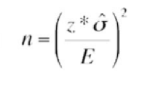
SAMPLE SIZE
Sample Size
Sample Size for Continuous Data
The total sample size is 60:
Before the improvement: 30 days
After the improvement: 30 days
With 90% confidence and margin of error 10, I would need at least 70 samples taken before the improvement and at least 27 samples taken after the improvement. Based on the calculated sample size, I was not able to collect enough sample data before the improvement due to time constraints, but I was able to collect enough sample data after the improvement.
90% Confidence: 1.65
Margin of Error: 10
Before the Improvement
LEVEL OF MEASUREMENT ERROR
Standard Deviation: 50.57
n = ((1.65*50.57)/ 10) ^2
= 69.20 (rounding up to 70)
The measurement of error is possible if I accidently included or excluded a transactions based on whether or not it met the 7 expense types being tracked for this project. After exporting Chase Bank statements, I tried doing my best to filter out bills, subscriptions, and medical expense transactions while manually sifting through the remaining transactions to code them into the 7 expense types.
In addition, I did my best to record in Excel any cash expenses at the end of the day, but there is a possibility that I might have forgotten a transaction or incorrectly recorded a transaction when made by cash.
After the Improvement
Standard Deviation: 31.50
n = ((1.65*31.50)/ 10) ^2
= 26.85 (rounding up to 27)

Slide 8
WHY
Current Process: Pareto Chart
A Pareto Chart was utilized to determine the spending activities on which I have spent most dollars and to identify the spending activities on which I have spent the most time before the process improvement.
RESULT
The chart above shows the top three activities where I spend the most dollars, which are Shopping for Event, Snack Runs, and Socializing. In addition, these three activities make up about 80% of my total spending dollars with my current process.
The bottom chart shows the top three activities where I spend the most time, which are also Socializing, Shopping for Event, and Snack Runs. These three activities make up about 90% of the my time spent on activities related to spending money.
When reviewing to change my process for improvement, I should focus on these three high spending activities in order to reduce my daily spending.

Slide 9
WHY
Correlation
A Correlation matrix was utilized to determine if there is a correlation in dollars spent and time spent on each respective spending activity before the process improvement.
RESULT
The matrix shows a positive correction exists between the dollars spent and time spent for Shopping for Event, Socializing, Snack Runs, Self Gifting, Meals, Gas, and Groceries. Based on this and practical understanding of my spending habits, it appears that the more time I spend on a spending activity that the more money I tend to spend.

Slide 10
WHY
Descriptive Statistics
Descriptive statistics was utilized to measure the change in the central tendency and dispersion of the data before and after the process improvement.
Before the Improvement
After the Improvement
RESULT
Comparing the before and after process improvement, the mean and median decreased by (-42%) and (-38%) in the new process.
A mode did not exist before the process change, but changed to 0 in the new process showing how I was able to reduce daily spending to 0 more frequently than before the process improvement.
The standard deviation shows less dispersion in the new process, indicating less deviation of daily spending from the mean compared to the before process improvement.

Slide 11
WHY
SQL (Sigma Quality Level)
Before the Improvement
SQL was applied to the process before the improvement in order to create a baseline to measure against the process after the improvement to determine success.
Defect opportunities per unit 1
Units produced 30
Total possible defects 30
Total actual defects 10
Defects per opportunity rate 10/30 =33.33%
DPMO 333333.33
SQL Value 2.0
DEFINITION
A “defect” is defined as total spending greater than $50 per day.
RESULT
After the Improvement
There was a change in the SQL value that was captured before and after the process improvement. Before the improvement, the SQL value was 2.0. After the improvement, the SQL value was 2.3.
The increase in the SQL value after the improvement depicts a successful process change. Respectively, the defect rate decreased from 33% to 20%.
Defect opportunities per unit 1
Units produced 30
Total possible defects 30
Total actual defects 6
Defects per opportunity rate 6/30 =20.00%
DPMO 200000.00
SQL Value 2.3

Slide 12
Process Changes
After analyzing 30 days of data in the current process, I knew I had to make a change to my current process in order to improve:
The Process Map showed the multiple snack runs after lunch, before class or studying, and before heading home. In the new process, snack runs will be eliminated throughout the day by buying a bulk pack of snacks and keeping them easily accessible in my bag and in my car. Therefore, when I need a snack, I do not have to waste time driving out to buy snacks, but instead grab some from my bag or car. (Refer to process map on next slide.)
The SQL showed high level of defects (total daily spending was greater than $50). In order to increase the SQL in the new process, I will give myself a daily budget of no more than $50 that I will try to uphold before participating in other activities that require spending.
The Pareto Charts showed that the top three high spending activities in terms of dollars and time were shopping for an event, snack runs, and socializing. The Correlation matrix showed strong positive correlation between time spent and dollars spent for these three activities. After analyzing the data, it appears that the more time I spend in a store or venue on these activities that the more I spend. Therefore, in the new process, I will reduce the amount of time I spend on socializing, shopping for an event, and snack runs.

Slide 13
Process Changes
Wake up/Get Ready
Eat Breakfast
Weekday?
Go Workout
Class or Study?
Grab snack from bag
Drive to Work
No
Yes
Yes
Study at home
Attend Class/ Study
Eat Lunch
No
Grab snack from bag
Yes
Needsnack?
Grocery Shopping
No
Gas if needed
Finish Work
Need to shop for event?
Yes
Go Shopping
Treat myself?
Yes
Shop for myself
Attend Class/ Study
Grab snack from bag
Yes
Class or Study?
No
No
Social event?
Yes
Get ready
Go to event/socialize
Go to event/socialize
Yes
Social event?
No
No
Buy food or grab snack from bag
Yes
Am I hungry?
Go Shopping
Yes
Need to shop for event?
No
Drive Home
No
Eat if needed
In the new process, snack runs will be eliminated throughout the day by buying snacks during my grocery shopping and keeping them easily accessible in my bag and in my car.
Therefore, when I need a snack, I do not have to waste time driving out to buy snacks, but instead grab some snacks from my bag or car.
Go Workout
Watch TV/ Go to Bed
Needsnack?
Yes
Grab snack from bag
No
Drive Home
Eat Dinner/Late Dinner
Watch TV/ Go to Bed

Slide 14
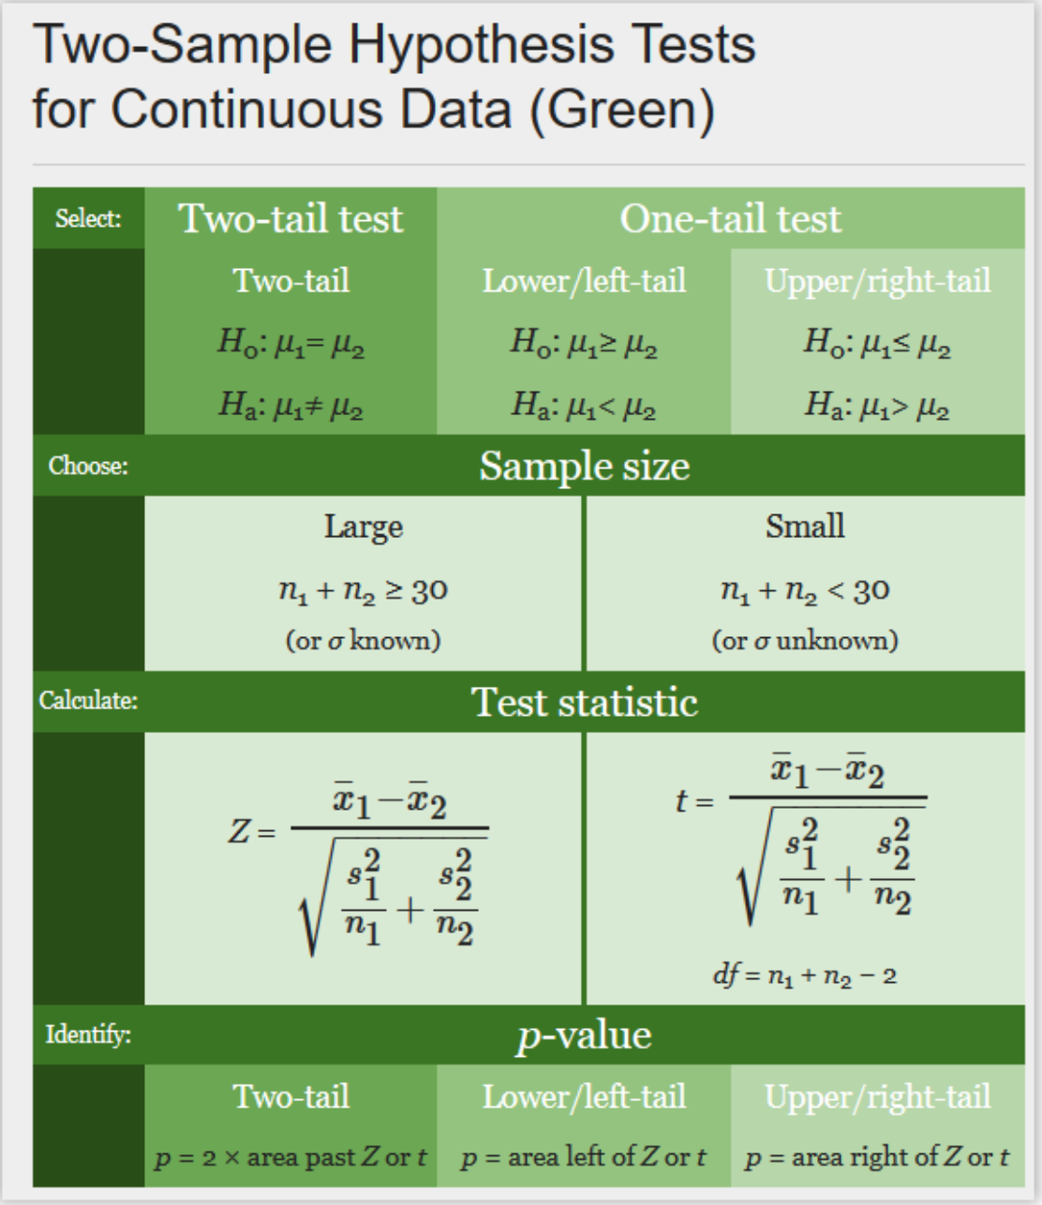
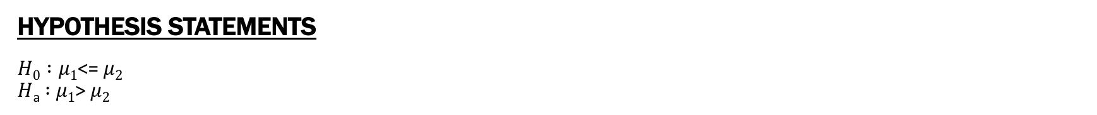
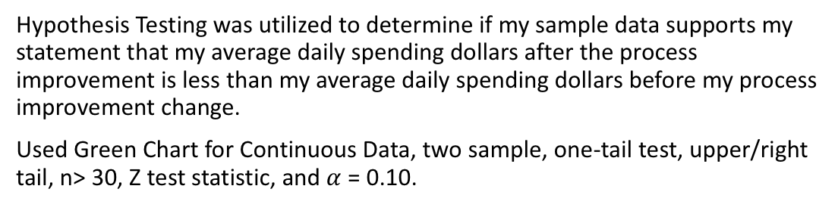
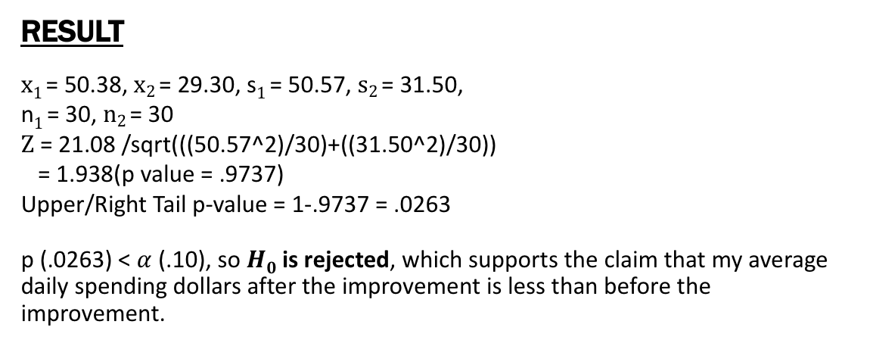
Hypothesis Testing
WHY
Hypothesis Testing was utilized to determine if my sample data supports my statement that my average daily spending dollars after the process improvement is less than my average daily spending dollars before my process improvement change.
Used Green Chart for Continuous Data, two sample, one-tail test, upper/right tail, n> 30, Z test statistic, and $α$ = 0.10.
HYPOTHESIS STATEMENTS
$H0 :μ1$<= $μ2$
$H$_{a} $:$ $μ1$> $μ2$
RESULT
$x1$= 50.38, $x2$= 29.30, s$1$= 50.57, $s2$= 31.50,
n$1$= 30, $n2$= 30
$Ζ$ = 21.08 /sqrt(((50.57^2)/30)+((31.50^2)/30))
= 1.938(p value = .9737)
Upper/Right Tail p-value = 1-.9737 = .0263
p (.0263) < $α$ (.10), so $H0$ is rejected, which supports the claim that my average daily spending dollars after the improvement is less than before the improvement.

Slide 15
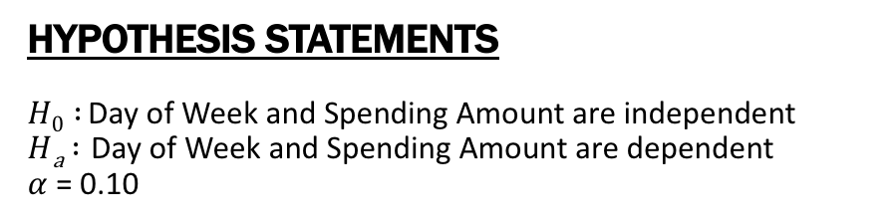
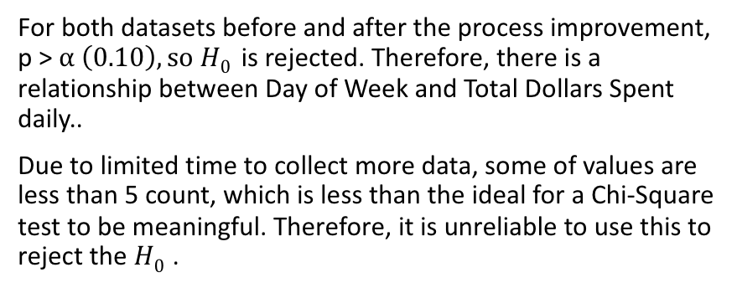
Chi-Square Test for Independence
WHY
The Chi-Square test was utilized to identify if Weekend or Weekday has a relationship with total dollars spent (Y) per day using categorical data. In order to use this test, I created two categories for total dollars spent (Y) based on my definition of defect. The two categories are <= $50 (daily spending is less than or equal to $50) and >$50 (daily spending is greater than $50). Weekday is a binary variable captured in my data, where 1 = Weekday and 0= Weekend. I will be using Weekend and Weekday as my other two categories.
HYPOTHESIS STATEMENTS
$H0 :$ Day of Week and Spending Amount are independent
$H$_{a} $:$ Day of Week and Spending Amount are dependent
$α$ = 0.10
RESULT
For both datasets before and after the process improvement, p > $α \left(0.10\right), so$ $H0$ is rejected. Therefore, there is a relationship between Day of Week and Total Dollars Spent daily..
Due to limited time to collect more data, some of values are less than 5 count, which is less than the ideal for a Chi-Square test to be meaningful. Therefore, it is unreliable to use this to reject the $H0$.

Slide 16
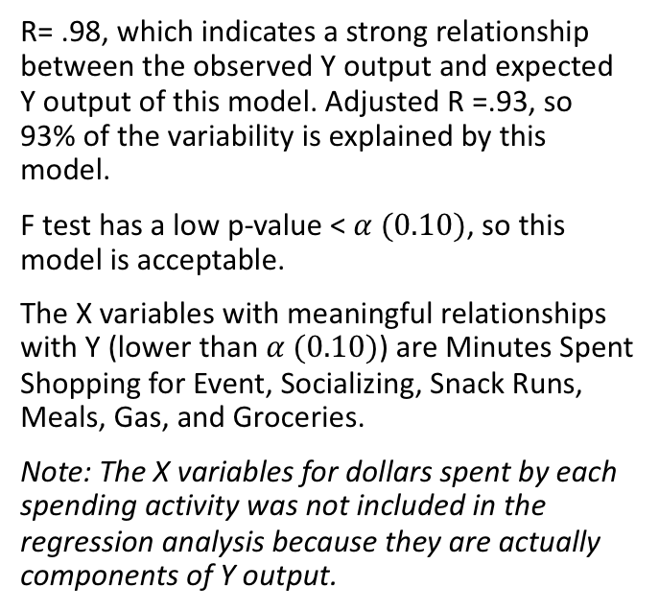
WHY
Multiple Regression Analysis (Before Improvement)
Multiple Regression Analysis was utilized to identify which of my X variables have a relationship with my Y variable (Total Dollars Spent) and strength of each of those relationships. I will run this on the data before the process improvement in order in order to analyze the relationships and create a baseline for after the process improvement.
RESULT
R= .98, which indicates a strong relationship between the observed Y output and expected Y output of this model. Adjusted R =.93, so 93% of the variability is explained by this model.
F test has a low p-value < $α (0.10)$, so this model is acceptable.
The X variables with meaningful relationships with Y (lower than $α (0.10)$) are Minutes Spent Shopping for Event, Socializing, Snack Runs, Meals, Gas, and Groceries.
Note: The X variables for dollars spent by each spending activity was not included in the regression analysis because they are actually components of Y output.

Slide 17
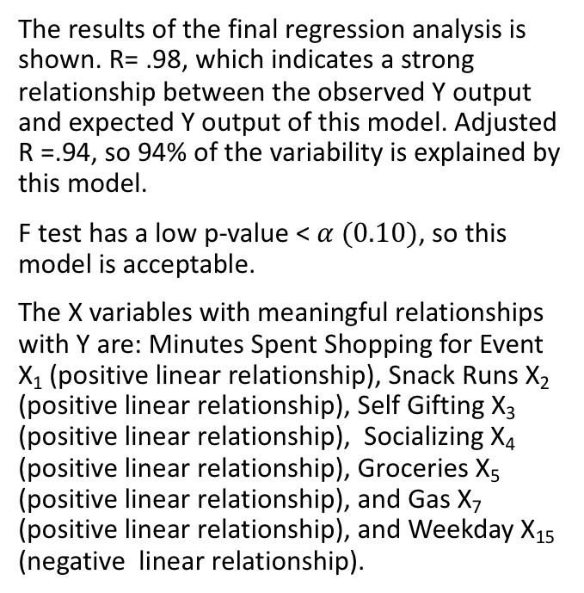
WHY
Multiple Regression Analysis (After Improvement)
I use the Multiple Regression Analysis on the data collected after the process improvement. I want to use the data from my improved process to make a model that would predict my Y, by using my X variables. To do this, I ran the analysis two three times to reduce my X variables to only the meaningful Xs with p-value < $α \left(0.10\right)$ and increase the predictability of the model.
RESULT
Regression Model
Y = 16.028+ 0.386X₁+0.455X₂+1.25X₃+ 0.570X₄+0.502X₅+2.131X₇-9.470X₁₅
The results of the final regression analysis is shown. R= .98, which indicates a strong relationship between the observed Y output and expected Y output of this model. Adjusted R =.94, so 94% of the variability is explained by this model.
F test has a low p-value < $α (0.10)$, so this model is acceptable.
The X variables with meaningful relationships with Y are: Minutes Spent Shopping for Event X₁ (positive linear relationship), Snack Runs X₂ (positive linear relationship), Self Gifting X₃ (positive linear relationship), Socializing X₄ (positive linear relationship), Groceries X₅ (positive linear relationship), and Gas X₇ (positive linear relationship), and Weekday X₁₅ (negative linear relationship).

Slide 18
WHY
IMR (XmR) Control Chart
The IMR (XmR) Control Chart was utilized to plot my total dollar spent (Y) from the 60 days of sample collected. Day 1 to 30 is before the process improvement. Day 31 is the start of the new process. This chart will help me monitor if my process is in control and if there’s a signal showing a change in the process.
RESULT
The old process from Day 1-30 has 13 data points above the mean with a larger distance from the mean, which indicates high daily spending. Two of the data points are above the UCL because I had to make two large purchases for wedding that I was part of the wedding party, which does not happen on a regular basis.
The new process from Day 31 to 60 shows 21 data points below the mean, which shows progress in decreasing daily spending after the process changes. Overall, looking at the charts, the new process is in control with the data points slightly below the average and variability but within the limits.

Slide 19
PURPOSE
Conclusion Summary
The purpose of this project is to help me reduce my daily spending and understand my spending habits. The goal is to reduce my daily spending by (-20%).
TOOLS UTILIZED
In order to reach my goal, I used the below tools to analyze my process and identify if the changes in my new process have worked and are in control.
To evaluate my old process before the process improvement and to create a baseline to measure against, I used the Process Map, Pareto Chart, Correlation Matrix, Descriptive Statistics, and SQL.
To determine if my average daily spending dollars decreased under my new process, I used Hypothesis Testing.
To determine if there is a relationship between categorical data (Day of the Week vs =<$50,>$50), I used the Chi-Square Test.
To identify which X variables had a relationship with my Y variable, the strength of each relationship, and create an acceptable predictive model for Y, I used Multiple Regression Analysis.
To measure success after the process improvement by comparing the new process results with the baseline, I used Descriptive Statistics and SQL.
To determine if there was a signal from the change in the process and monitor if the new process is in control, I used the IMR (XmR) Control Chart.

Slide 20
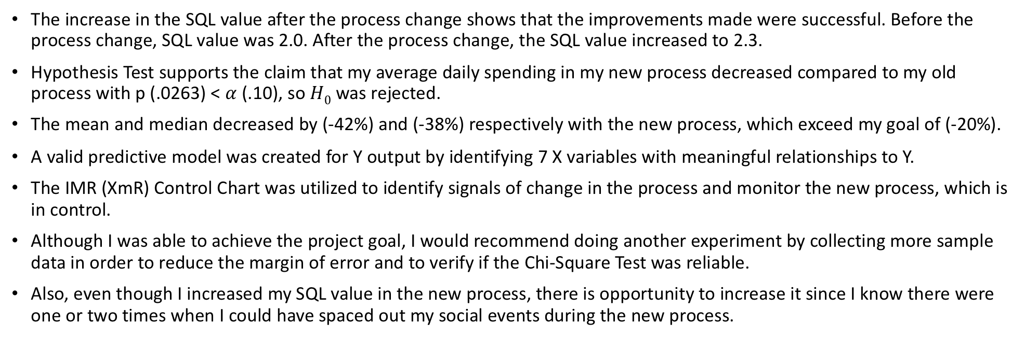
RESULTS
Conclusion Results
The increase in the SQL value after the process change shows that the improvements made were successful. Before the process change, SQL value was 2.0. After the process change, the SQL value increased to 2.3.
Hypothesis Test supports the claim that my average daily spending in my new process decreased compared to my old process with p (.0263) < $α$ (.10), so $H0$ was rejected.
The mean and median decreased by (-42%) and (-38%) respectively with the new process, which exceed my goal of (-20%).
A valid predictive model was created for Y output by identifying 7 X variables with meaningful relationships to Y.
The IMR (XmR) Control Chart was utilized to identify signals of change in the process and monitor the new process, which is in control.
Although I was able to achieve the project goal, I would recommend doing another experiment by collecting more sample data in order to reduce the margin of error and to verify if the Chi-Square Test was reliable.
Also, even though I increased my SQL value in the new process, there is opportunity to increase it since I know there were one or two times when I could have spaced out my social events during the new process.

